Slide 1
The Customer's Market
Analysis Insights
Shivam Tyagi

Slide 2
Objectives
The Customer’s Market® is a Super Market in Myanmar
Find insights on increasing Customer Retention
How timings affect Customer Behavior

Slide 3
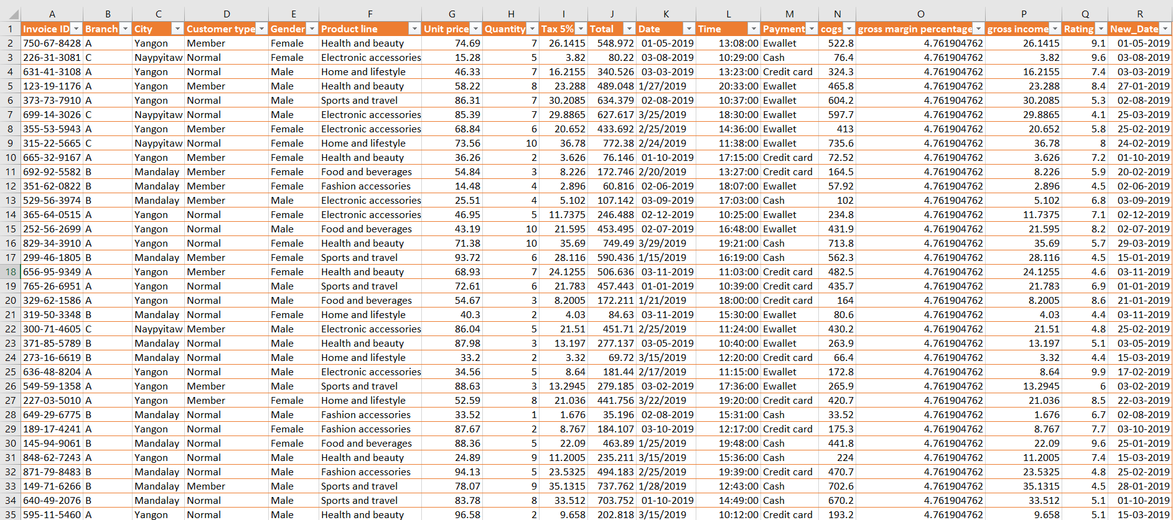
Data Table Snap Shot
First Few Rows Of Clean Data
Figure:
First Few Rows Of Clean Data

Slide 4
Data Dictionary
Variables | Type | Description | Comments
Branch | Text | Which Branch made that sale? | Branch – A, B, or C
City | Text | Which City did that sale occur in? | City – Nay Pyi Taw, Yangon, or Mandalay
Customer type | Text | Whether he has taken membership or not? | Member or Normal
Product line | Text | Which of the 6 product line? | Product Lines: Health and Beauty || Electronic Accessories || Home and Lifestyle Sports and Travel || Food and Beverages || Fashion Accessories
Date | Date/ Text | What day did the sale occur? | #Data Type Mismatch
Rating | Float | Any value between 0 to 10 | Always stays above 4
New_Date | Date | What day did the sale occur? | Improvised Date Column

Slide 5
Data Pre Processing
Data Cleaning
Standardization
Pivot Tables
Experimenting
Charts & Dashboard
Charts Creation
Introducing Slicers & Timeline
Detecting Meaningful Charts

Slide 6
Standardization
Date
01-01-2019
02/01/2019
Homogenous Data
02/01/2019 (text) to
02-01-2019 (date)
New_Date
01-01-2019
02-01-2019

Slide 7
Insights From Data

Slide 8
Cash
01
Users

Slide 9
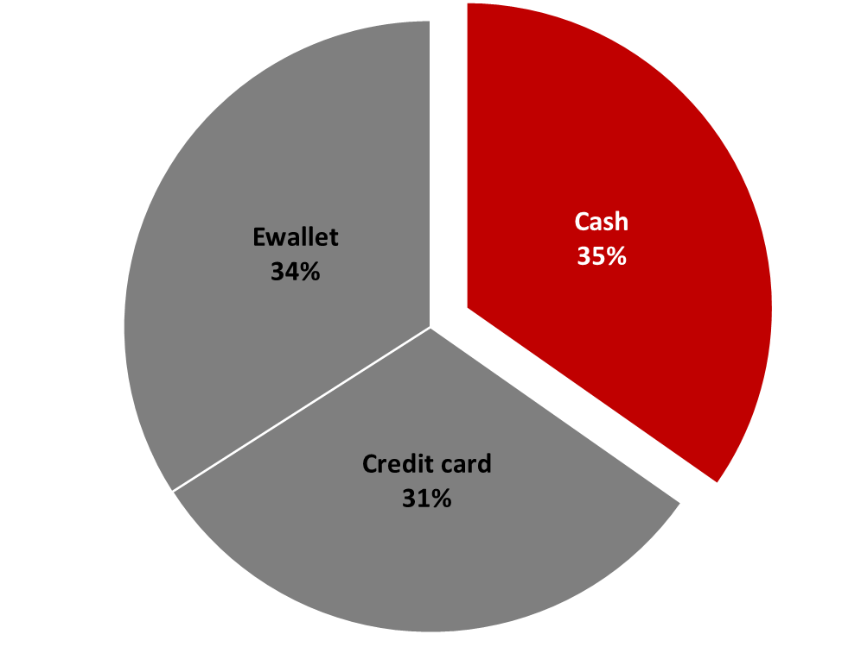
35%
Of Customers pay in Cash

Slide 10
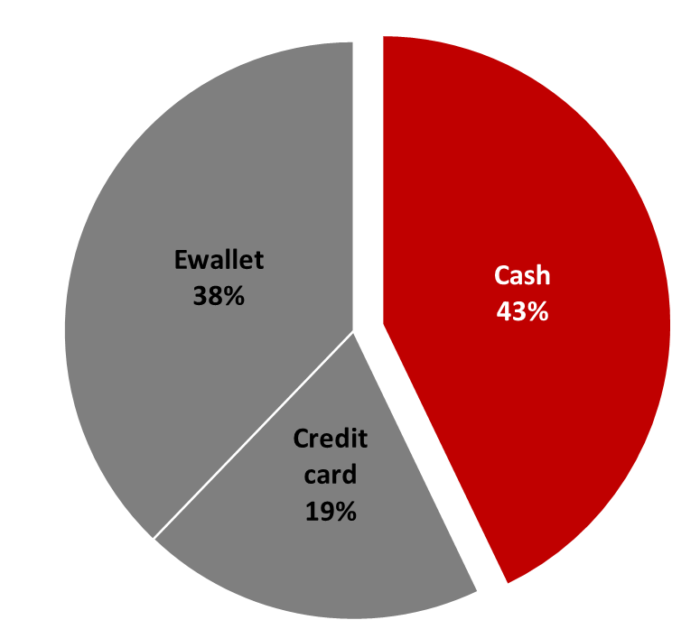
40% +
Customers in Nay Pyi Taw, pay using Cash

Slide 11
Opportunity
Credit Cards
Offer discounts on purchase through Credit Cards
Credit Card companies shall offer discount
E-Wallets
Personalized E-Wallets will increase Customer Retention
This will shoot up the Count of Members

Slide 12
Rush
02
Hours

Slide 13



01 & 03 PM
In the Noon
10 AM
In the Mornings
07 PM
In the Evenings

Slide 14
An obvious conclusion is to be readily available
around these
times
Though there is more to this
than what
meets the eye

Slide 15

Worst
03
Ratings

Slide 16
4 – 5 Ratings
Attain their Peak During
12 PM
03 PM &
07 PM
This seems to imply a correlation between
Rush Hours & Low Ratings

Slide 17
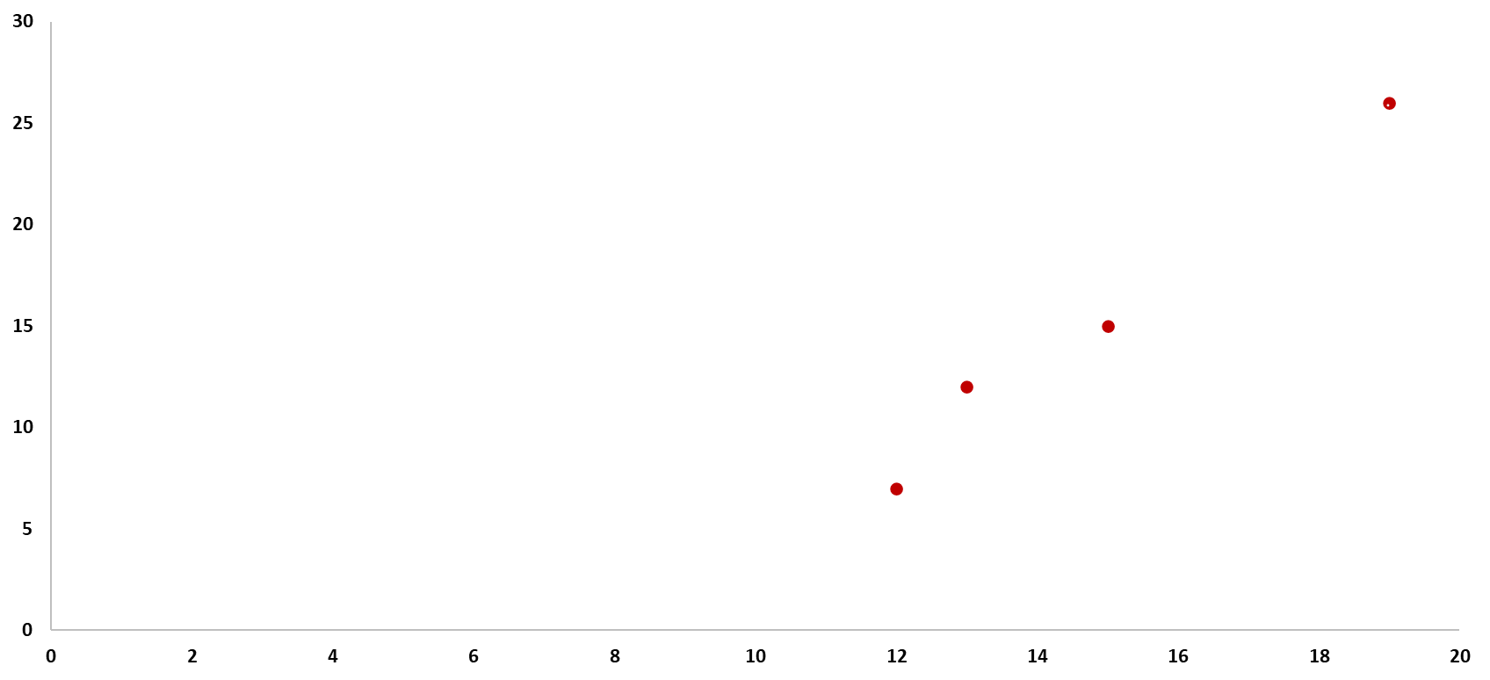
Count Of Low Ratings
Rush Hours
If we are only considering the peak hours,
we observe a very strong Correlation
R = 0.9908

Slide 18
Measures could be taken to improve service during
Rush hours

Slide 19
Possible Measures
Self Check Out
Self Check-Out Option for E-Wallet Customers
This would further increase membership
Ask The Customer
Asking customers what they didn’t like
They will feel heard & we would know the issue
Active Counters
Making sure all counters are active
Obvious but necessary to be emphasized

Slide 20
The Dashboard

Slide 21
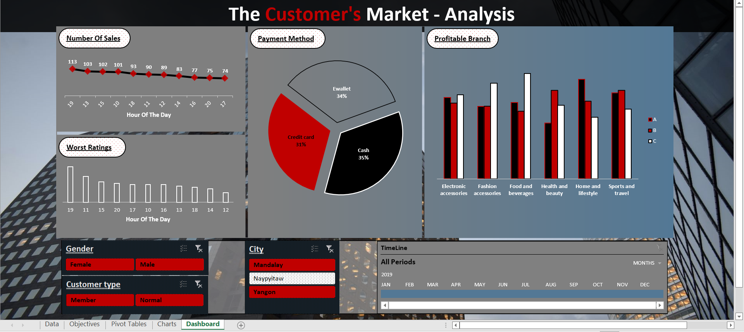

Slide 22
THANK YOU!

